Slide 1

The Dual Foundations of the Administrative State.
A Comparative Study of Leadership Assets within the Greek Civil Service and Educational Sector
Dr. Lalos Christos
University of Alicante xristoslalos@gmail.com

Slide 2


ADMINISTRATIVE DUALISM
Context of Modernization
The Dualism
The modernization of the Greek public sector has been the central narrative of state reform for the better part of the last decade, driven initially by fiscal conditionality and subsequently by an endogenous drive towards digitization and administrative efficiency.
While both groups share the constitutional status of permanent civil servants, they operate under fundamentally divergent regulatory frameworks, cultural expectations, and professional trajectories.
Within this overarching project of the "Executive State" (Epiteliko Kratos), codified in Law 4622/2019, two distinct yet interconnected ecosystems of human capital have emerged.
The systemic friction between a managerial profile (Public Admin) and a pedagogical profile (Education) creates barriers to synergy and talent mobility.

Slide 3
REFORM CONTEXT & EVOLUTION
2010-2018
2019
2021
2022-Present
Memorandum Era: Focus on fiscal stabilization and early depoliticization attempts (Law 4369/2016).
Law 4622/2019: Introduction of the Executive State. Separation of strategy from operation.
Law 4823/2021: Upgrading the School Unit. Focus on pedagogical accountability and unit autonomy.
Law 4940/2022: Shift to NPM principles, goal-setting, and 360-degree feedback mechanisms.

Slide 4




DEFINING THE TWO TARGET GROUPS
Public Admin Executives (PAE)
Heads of Units, Directorates, and General Directorates. Their role is primarily managerial, strategic, and operational. They function within the results-oriented framework of Law 4940/2022, emphasizing efficiency and soft skills.
Education Executives (EE)
School Principals, Directors of Education, and Advisors. They manage school units while providing pedagogical supervision. Operates under Law 4823/2021, tethered to a pedagogical bureaucracy model.

Slide 5






PUBLIC ADMIN: THE COMPETENCY SHIFT
Law 4940/2022 marks a radical departure from Weberian procedural legality toward a results-oriented culture structured around three pillars:
Goal Achievement
Skills Assessment
Team Pulse
50% Weighting: Managers are evaluated on measurable quantitative and qualitative targets, linking individual performance to organizational strategy.
40% Weighting: Formally introduces a "Competency Framework" (soft skills) including adaptability, team management, and emotional intelligence.
10% Weighting: 360-degree feedback where subordinates anonymously assess the leadership style and team climate.

Slide 6


EDUCATION: CREDENTIALIST HIERARCHY
Primus Inter Pares Model
Leadership in Education is constructed as a derivative of teaching experience and academic accumulation rather than specific managerial training.
Scientific Training: High weighting for PhDs and Masters, leading to "credential inflation" without necessarily increasing management skills.
Service Tenure: Minimum 8 years required, but seniority is often the decisive factor in practice.
Pedagogical Bias: The selection process focuses heavily on pedagogical scenarios rather than crisis or resource management.

Slide 7

THE AUTONOMY PARADOX
0%
Administrative Burden
While a Director in a Ministry (PAE) has authority over unit goals and resource allocation, a School Principal (EE) functions largely as an intermediary for central directives from the Ministry and IEP.
Hiring Autonomy for Principals
Greek schools are among the least autonomous in the OECD. Principals have no authority to hire/fire staff or significantly control budgets.
Principals spend a disproportionate amount of time on clerical tasks due to lack of secretarial support, hindering transformational leadership.

Slide 8
PA SELECTION: THE "BEST FIT" PRINCIPLE
The weighting of formal qualifications is balanced by the Structured Interview, allowing younger, highly skilled professionals to advance if they demonstrate superior competency fit.
ASEP Oversight: Selection is strictly supervised by the Supreme Council, ensuring transparency and objectivity.
Structured Interviews: Assessment of managerial capability and alignment with specific job descriptions.
This creates a technocratic elite selected for specific competencies (e.g., law drafting, data analysis) rather than general tenure.
The Executive Branch: Fast-track stream (Klaados Epitelikon Stelechon) with rigorous AI-proctored exams and policy analysis case studies.

Slide 9

EE SELECTION: POINTS ACCUMULATION
The Objective Point System
Litigation Focus: Rigid points systems are used to minimize union suspicion and political favoritism, but they sacrifice "fit."
The selection matrix is rigid. Points are awarded for formal credentials (PhD, Master's, Foreign Languages, ICT certs) and service years.
The Interview: While assigned significant weight in Law 4823, it often focuses on pedagogical scenarios rather than leadership soft skills.
A candidate with a PhD in an unrelated field is technically eligible over a candidate with an Educational Management degree if the former has more tenure.
Seniority Bias: Successful candidates often have 2+ decades of experience, weighting the system toward seniority.

Slide 10
SELECTION DRIVERS: SIDE-BY-SIDE
Feature | Public Administration (PAE) | Education Executive (EE)
Primary Logic | Competency-based ("Best Fit") | Credential-based ("Accumulation")
Minimum Tenure | Variable (4+ years for specific roles) | 8 Years Teaching Service
Key Credential | Proven Managerial/Policy Experience | PhD/Master's + ICT Cert
Interview Focus | Strategic Planning, HR Management | Pedagogical Scenario, Personality
Evaluators | Specialized Councils (ASEP/EKDDA) | Local Selection Boards
Fast Track? | Yes (Executive Branch Program) | No (Strict Seniority Ladder)

Slide 11






THE "SOFT SKILLS" GAP
Leadership in PA
Conflict in Education
Adaptability
Focus on Coaching & Mentoring. The goal is to transform the traditional "Director" into a "Leader-Coach" who inspires teams and fosters collaboration.
Competency is pedagogical. Principals focus on instructional methods and climate. Lack of training in digital leadership creates a deficit in digital transformation.
PAEs are trained to manage change in volatile environments. EEs are structurally confined to administering central circulars and routine bureaucracy.

Slide 12

INSTITUTIONAL ASYMMETRIES
EKDDA: The Strategic Academy
The National Centre (EKDDA) serves as the "brain" of the civil service. Its school (ESDDA) produces permanent officials through years of specialized education.
The Education Training Void
There is no National School of Educational Leadership. Training is provided ad-hoc by IEP or Universities, often disconnected from daily operational realities.

Slide 13
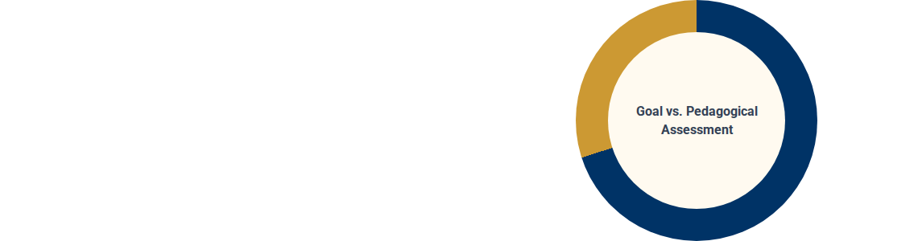
EVALUATION: COMPLIANCE VS. CONFLICT
PA: Linking Reward to Goals
Evaluation is annual, digital, and involves goal-setting discussions. It is explicitly linked to a Reward System (Bonus), generally accepted as a tool for improvement.
Education: The Battlefield
Evaluation has been a 40-year ideological conflict. Trade Unions (DOE/OLME) view individual assessment as a punitive mechanism leading to dismissals.

Slide 14

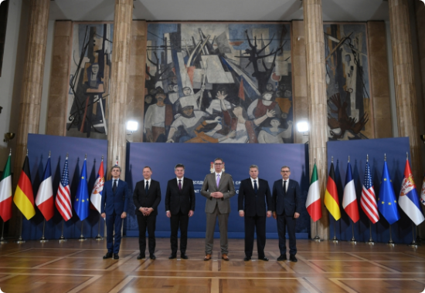
MOBILITY & STRUCTURAL BARRIERS
The Unified Mobility System (ESK) aims for fluid talent movement, yet movement between Education and Admin is unidirectional.
The "Metataxi" Phenomenon: Teachers seek admin posts to escape classroom burnout, yet they often lack administrative hard skills.
Reverse Mobility Barrier: Admin executives cannot become principals due to the strict 8-year teaching requirement.

Slide 15


EUROPEAN DIMENSION (OECD/TALIS)
Postgrad Qualifications
Formal Admin Training
Principal Autonomy
TALIS 2018 confirms: Greek principals are highly educated but report the lowest levels of preparation for administrative office.

Slide 16

CONCLUSION & SYNERGIES
National School for Ed-Leadership: Establish a dedicated department within ESDDA/EKDDA.
Final Outlook
The Executive State cannot succeed if its largest branch remains distinct from modern management. Convergence is required not just in law, but in the selection and training of leaders.
Professionalize School Units: Dual-leadership (Pedagogical Head + Admin Manager).
Harmonize Evaluation: Introduce "Team Pulse" feedback to schools to foster collaboration.
Thank you for your attention!

